Slide 1

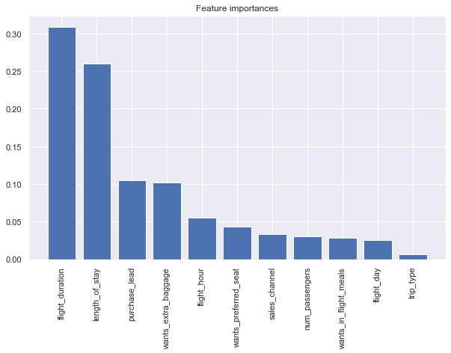
85% cross val score with a 78% accuracy in prediction.
MODELLING RESULTS: Random Forest
This plot shows how each variable contributed to the model.

